Slide 1
Making Connections: Librarians Partnering to Build Information Literate Patrons
Heather Moorefield-Lang
Associate Professor
School of Library and Information Science
University of South Carolina

Slide 2
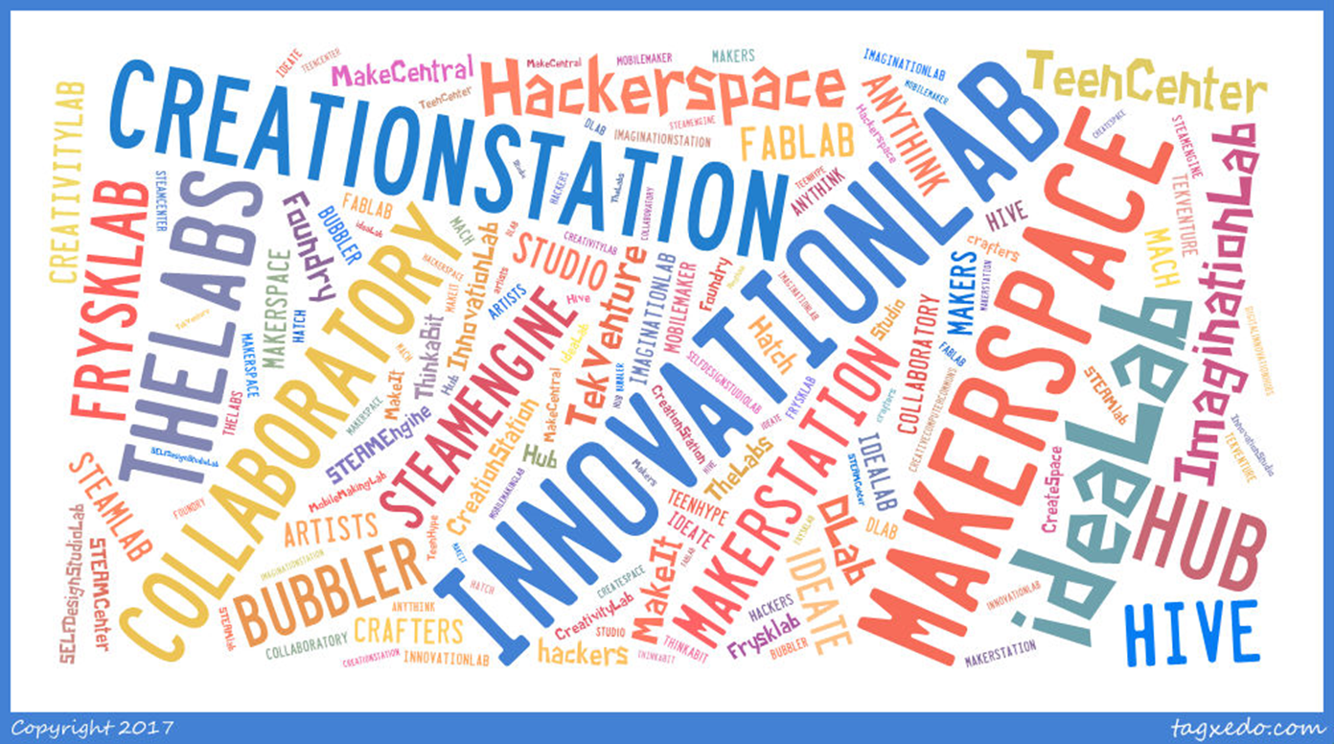
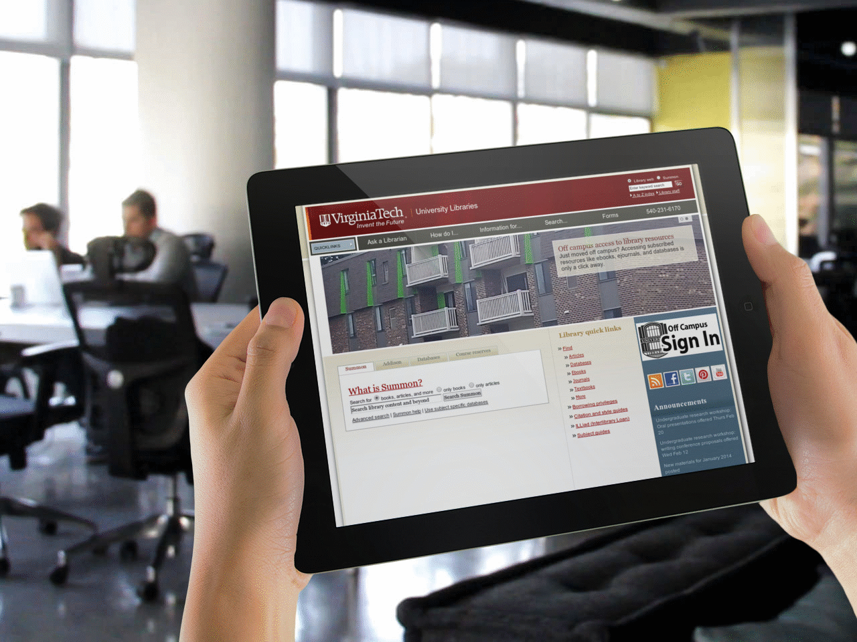

Slide 3
Tablet Computers in Libraries: ALA Editions

Slide 4
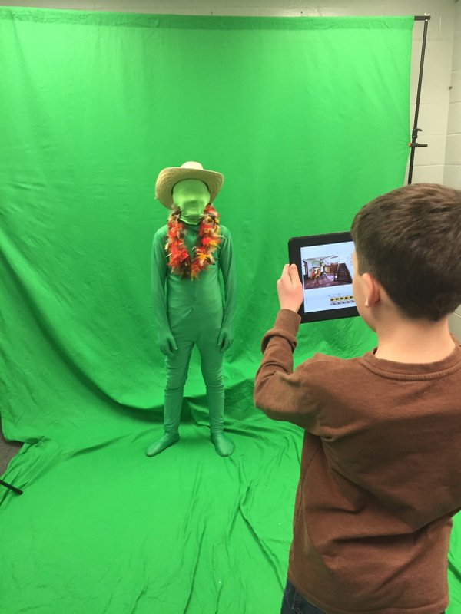
Makerspaces in Libraries
Comparative study between school, academic, and public library makerspaces
User agreement content study of makerspaces
Mobile makerspaces
Training maker librarians
Accessibility in makerspaces
Makerspaces in action
Lessons learned from first makerspaces when building the next
Image Courtesy of Leah Jolly

Slide 5
Connections in Information Literacy Across Libraries
My High School Senior is your College Freshman

Slide 6
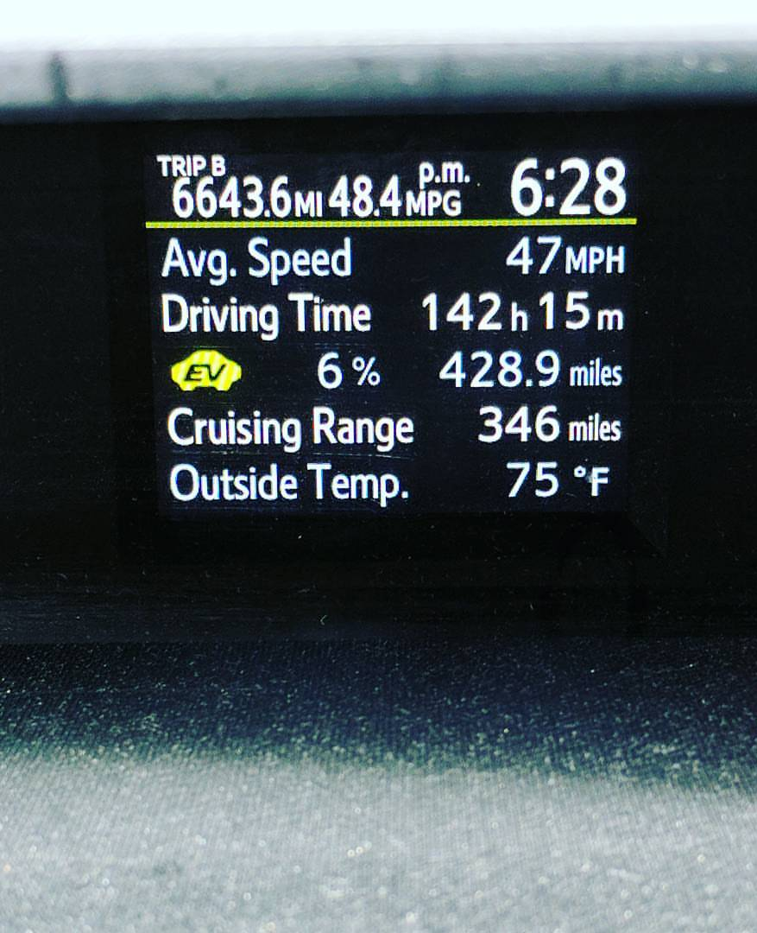
Planning

Slide 7
Connections in Information Literacy Across Libraries
My High School Senior is your College Freshman

Slide 8
Not a New Topic
But a Continuous Concern and Focus

Slide 9
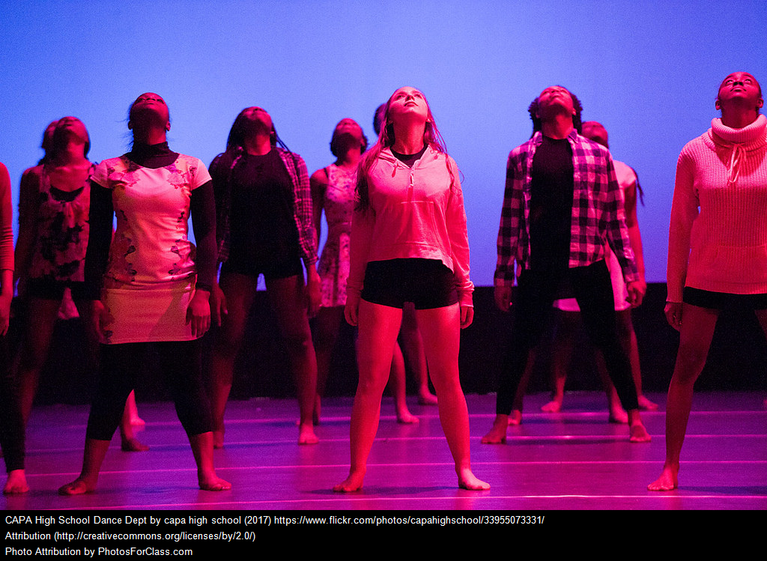
High School Seniors

Slide 10
Tell Me About Them!
What are high school students like?
Especially seniors?

Slide 11
What Are They Being Assigned?
Career pathway research projects
Panel discussions/supporting research on current topics
Subject based research
Senior portfolio projects (depending on the school)
It is not consistent

Slide 12
A Transition Checklist for High School Seniors (School Library Monthly)
Students don’t know what they don’t know
Students are sometimes unsure of how to phrase, narrow, or hone in on research questions
Students are unsure of information literacy skills, how to be critical of the information they have gained
This is where the school and public librarians come in.

Slide 13
College Freshmen
Include Transfers Here

Slide 14
Tell Me About Them!
What are undergrads like?
Especially freshmen?

Slide 15
A few Examples of Assignments
Annotated bibliographies on a mix of topics
Persuasive speeches
Informative papers
Research papers on a myriad of topics
Undergrad research posters
Panel research projects

Slide 16
Handy Checklist
General
Do they know what they don’t they don’t know
Know who to ask for research help
Understand library jargon
Research Process or Questions
Follow research process
Estimate time required for research
Define a research question or topic

Slide 17
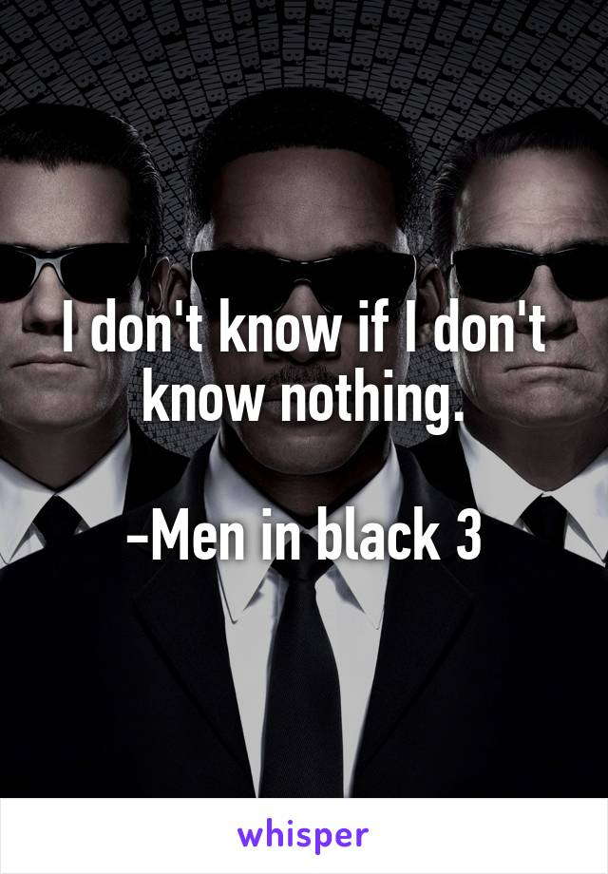

Slide 18
What are we all trying to achieve

Slide 19
Our Jobs are pretty similar

Slide 20
Searching for Information
Find different formats of information
Understand that Web search engines rarely locate good information
Distinguish between databases
Conduct effective searches
Interpret search results
Find full text of articles
Find books using Library of Congress
Try again when at first don’t succeed

Slide 21
Evaluating Information
Weed through search results
Evaluate information
Distinguish between popular and scholarly articles
Disregard inadequate or inaccurate information

Slide 22
Using Information
Synthesize, communicate, and argue using evidence
Analyze data and statistics
Represent, analyze, and critique the words and ideas of others ethically
Write without plagiarizing (accidentally or otherwise)
Cite sources properly using multiple citation styles

Slide 23
What Are High School Librarians Doing?
To Bridge the Gap?

Slide 24
Research Projects
Makerspaces
University/HS Collab
Mentoring Programs
Collaboration with Peer Educators
Training students in more than one citation style
More, much, much more……

Slide 25
What Are College Librarians Doing?
To Bridge the Gap

Slide 26
Research Projects
University/HS Collab
Mentoring Programs
Collaboration with Peer Educators
Training students in more than one citation style

Slide 27
Also Providing Access to…….
Reference Services
Writing Centers
Makerspaces
Communication Labs
One on one research aid
Library orientations
24/5 or 24/7 access
More, much, much more……

Slide 28
Orientation
So Important!

Slide 29
Some examples
Game Nights (VT and USC)
Poker Stations (Hollins)
Orientation Quiz Bowl (VT)
Open House (Multiple)
Classic Game Night (Multiple)
Luau (Penn State)
Murder Mystery and Escape Rooms (Works better in some places that others)

Slide 30
Keep Em Coming
Karoke Nights
Game Nights
Grilled Cheese
Coffee (Lets just say free food/drink)
Pet Therapy
Photo Booths
Exhibits
Performances
And much more……

Slide 31
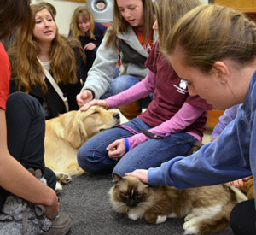
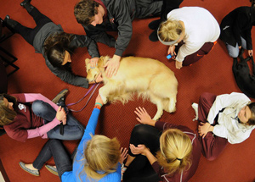
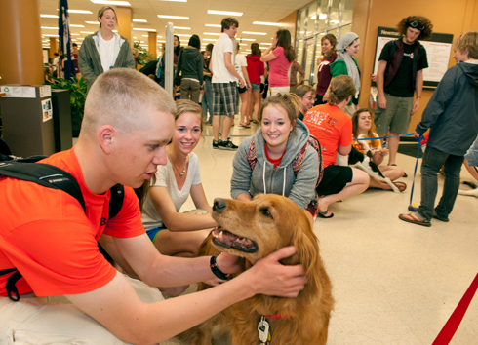
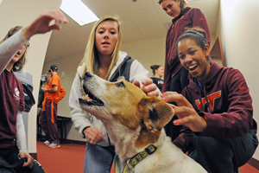

Slide 32
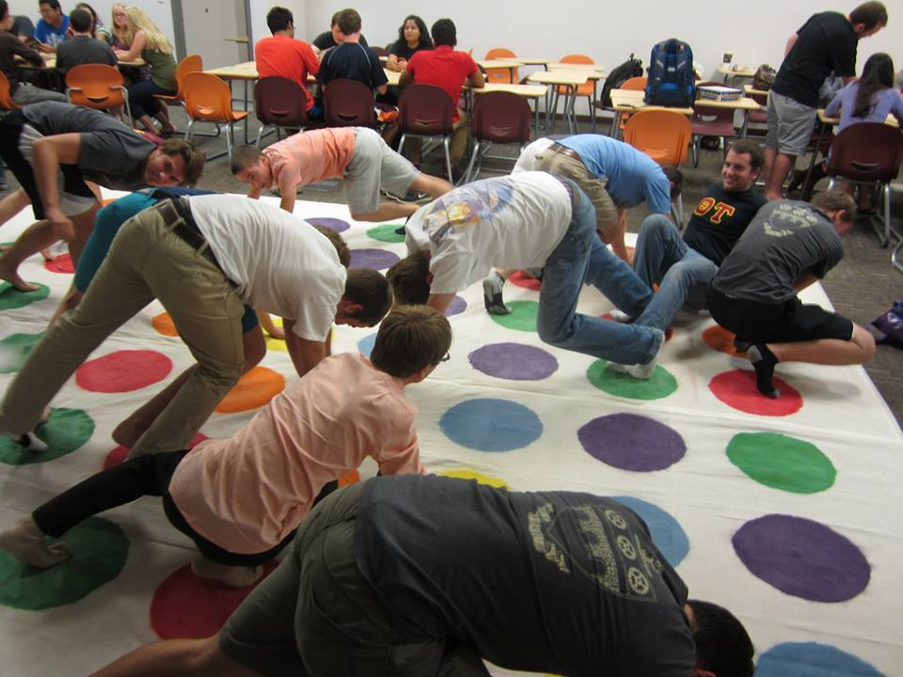
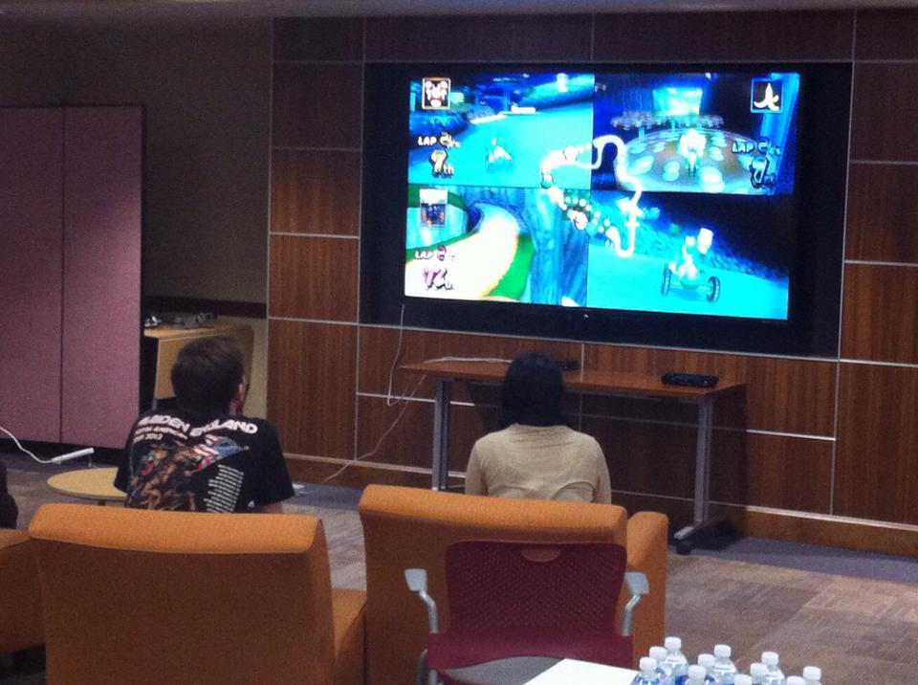
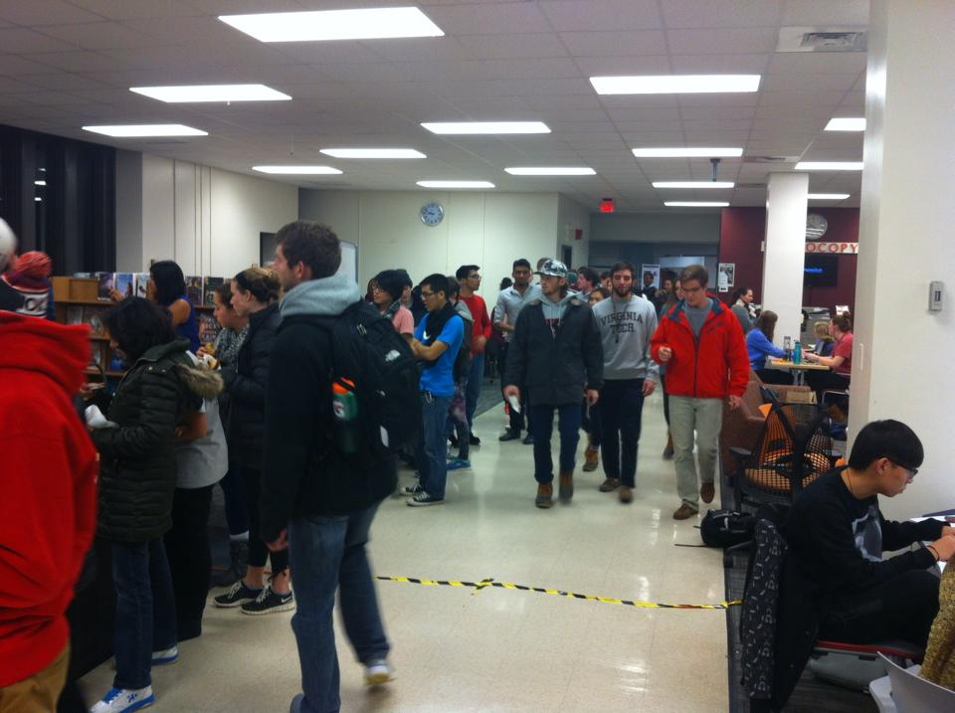
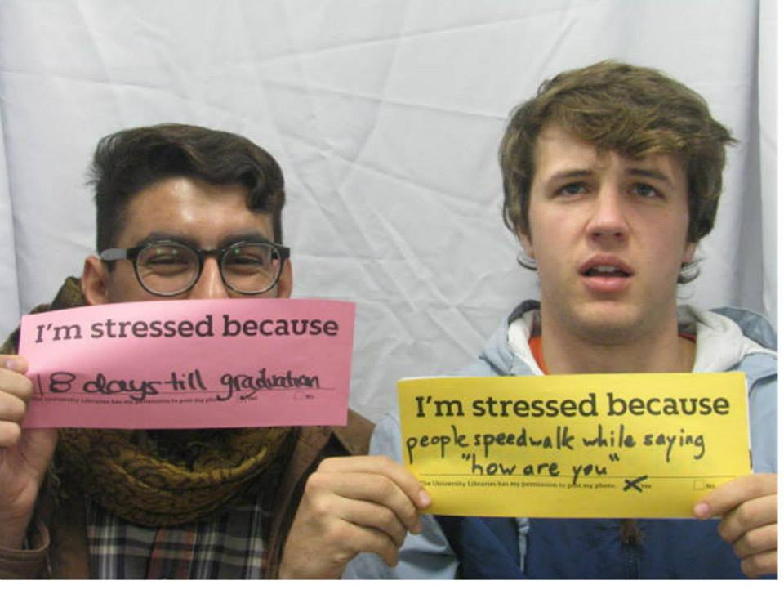
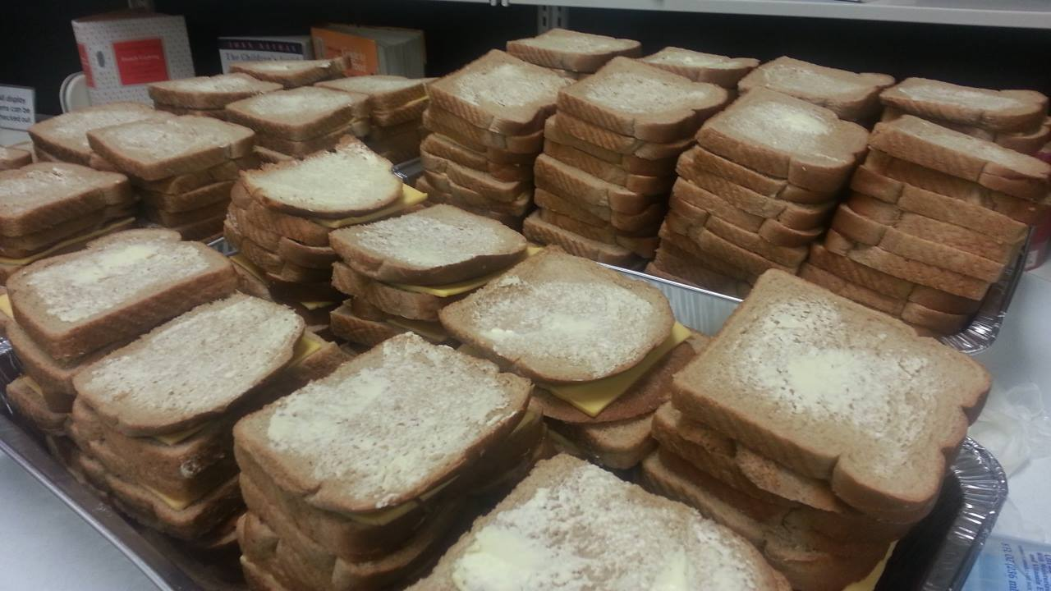

Slide 33
No matter how large, well stocked their high school library was. No matter how awesome their high school librarian may have been. A university library is overwhelming. Together we can aid our students.

Slide 34
Our latest Attempts
SLIS, SCASL, and Faculty at Thomas Cooper

Slide 35
Information Sheet
One sheet on research expectations at the college level
Created for school administrators
Focus on importance of librarians and research skills
Focus on transition from school to college and how libraries help.

Slide 36
Tech Fifteen

Slide 37
Short Videos
Integrate Technology
Easily Accessible
Closed Captioned, Universal Design

Slide 38
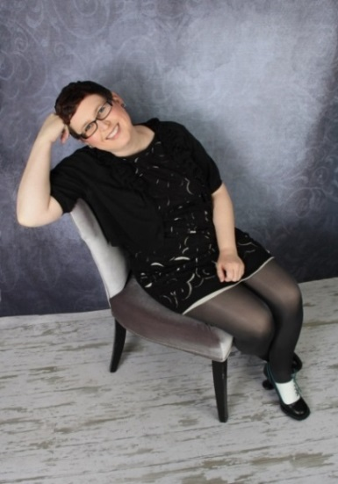
Questions?
Heather Moorefield-Lang
moorefield-lang@sc.edu
@actinginthelib
www.techfifteen.com

